Slide 1


SHIELD INSURANCE SALES INSIGHTS

Slide 2

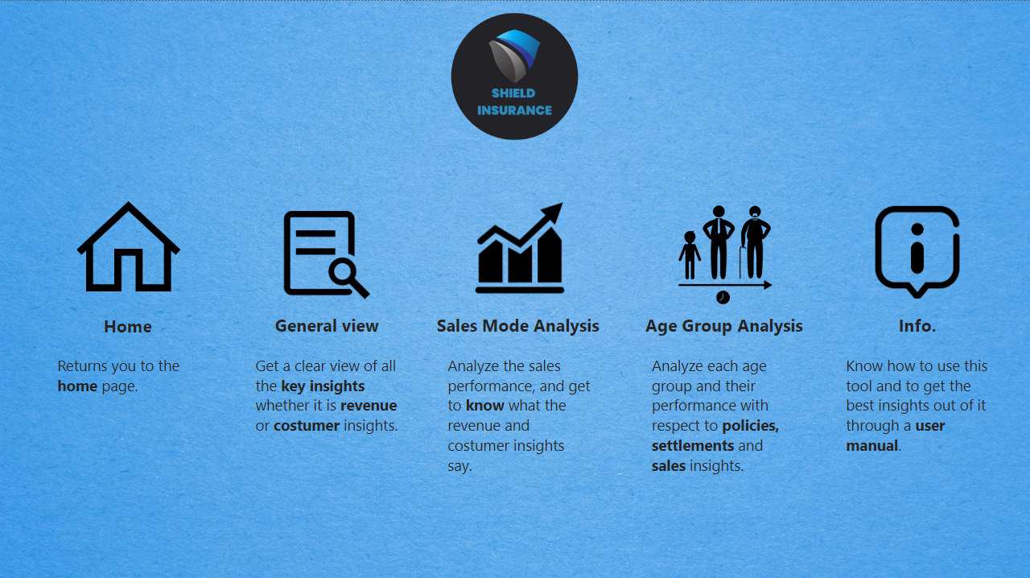
SHIELD INSURANCE SALES INSIGHTS
The purpose of this presentation is to get familiar with tool and its various features

Slide 3
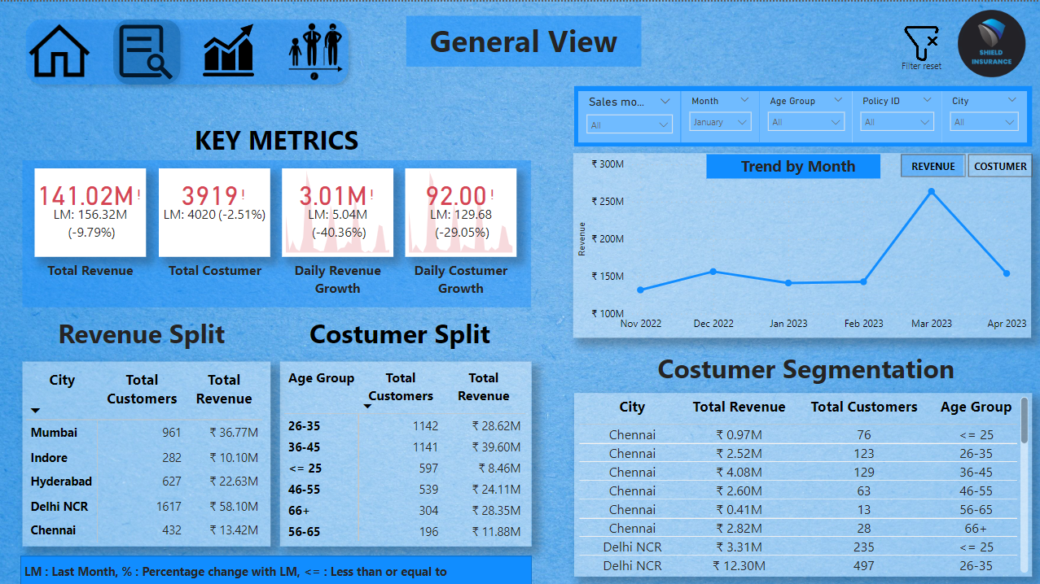
Page Navigation
The following icons on the pics. are the navigation buttons, that helps to direct to the desired page on the dashboard.
By clicking on the desired button, you will be directed to that desired page.

Slide 4
Using Filters
Filters enable users to narrow down and concentrate on particular data elements by applying specified criteria, such as date range, category, or numerical value.
By using filters, you can quickly analyze and extract meaningful insights from large datasets without having to manually sift through irrelevant data.

Slide 5
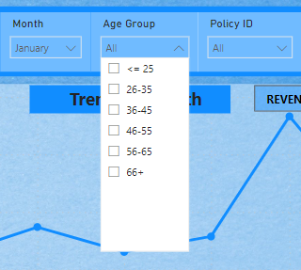
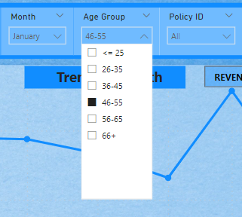
How to select one value from drop down
Select any filter of your choice, for example as shown in pic. B.
And then select a option on which you want the filter to be set, as shown in pic. C.
A
B
C

Slide 6
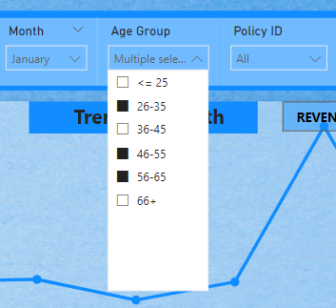
How to select multiple value from drop down
Select any filter of your choice, for example as shown in pic. B.
Then select multiple options while holding CTRL key or Command Key as shown in pic. C.
A
B
C

Slide 7
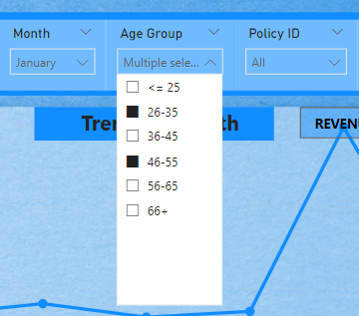
How to deselect values one by one
While holding CTRL or command key click the selected option one by one to deselect the desired options as shown pic. below.
A
B
C

Slide 8
Cross Filtering
Cross-filtering is a robust data analysis method that enables the filtration of data in one visualization or dashboard according to the selections made in another visualization or dashboard.
Selecting a data point, like a category or date range, in one entity, such as a chart or table, automatically filters connected entities, streamlining data display.

Slide 9
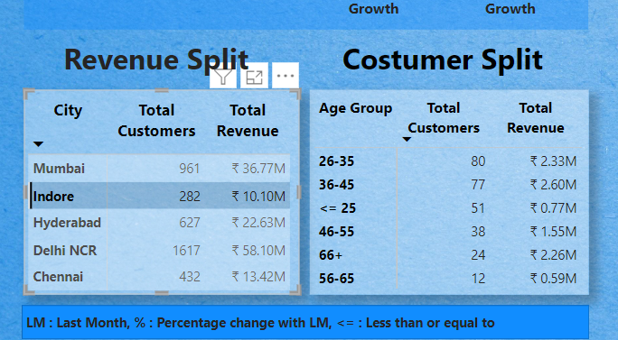
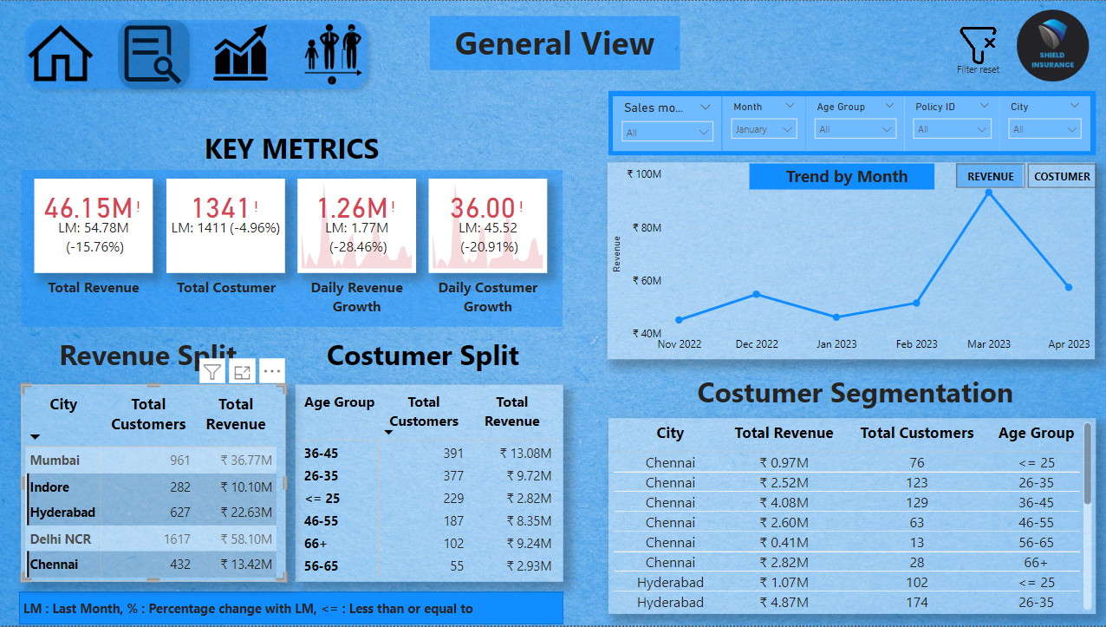
Cross Filtering
To perform cross filtering, just select on any data value on any visual, as shown in pic. A.
And to perform multiple select, hold CTRL or command key while clicking the desired values on the visual, like shown in pic. B.
A
B

Slide 10
How to deselect values by using clear filter
To deselect all the values or filter click on the reset filter button.
In case of cross filtering just double click on the visual or hold CTRL or command key to deselect one be one.

Slide 11
Thank you

